Slide 1
Capstone Project – Dec’2016-17 Batch
Sentiment Analysis of
Book Reviews
Presentation by
Abhinandan Nuli | Hrishikesh Bhatkhande | Mohit Sharma | Vivek Chutke
12-Aug-2017
Notes:
My notes

Slide 2
Agenda
1 | Background of the project & workflow
2 | Current Status
3 | Challenges & Risks
4 | Next Steps

Slide 3
Background
Project Title
Sentiment Analysis of Book Reviews
Input Data Source
Online book reviews of 8 Amazon books that contain rating on the scale of 1 to 5 and the text of actual review
Project Goal
Create a machine learning model to extract the sentiment out of the actual review based on the presence and frequency of positive and negative words in the review Use bag of words and Word-to-vec approaches to extract the sentiment and context Use Classification model such as Naive Bayes to train, validate and test the tokenized and cleaned up review data along with the actual ratings.
Project Team
Vivek Chutke Mohit Sharma Hrishikesh Bhatkhande Abhinandan Nuli
Technology & Software
Programming Language – R Software – R Studio Python(Future)

Slide 4
Background
Workflow
Input Data
Obtaining Data
Data file Sources | Amazon book reviews crawled from the net using multiple technologies – Amazon APIs, Selenium
Data file Features | - Reviews of 8 books crawled - Files are provided in .csv format, containing the reviews within the html tags
Data Exploration
Data Preparation / Curation
Model Creation
Model Validation
Model Implementation
Tracking

Slide 5
Current Status
Workflow
Current Stage
100%
Model Creation & Model Validation
Obtaining Data
Overall Schedule RYG Status
100%
Data Exploration
80%
Data Preparation / Curation
50%
30%
0%
Model Creation
Model Validation
Model Implementation
0%
Tracking

Slide 6
Current Status – Data Exploration
Data Exploration
Assessment of significance of all data columns and removal of unwanted data columns
Sanity checks of the important data (missing values, NA’s etc.)
Removal of html tags from the review text
Comparison of distribution of ratings across all 8 book reviews
Assessment of frequency distribution of reviews based on review lengths and removal of extremes (especially extremely large reviews)
Identifying data for creating a prototype model (relatively uniform distribution across reviews preferred)

Slide 7
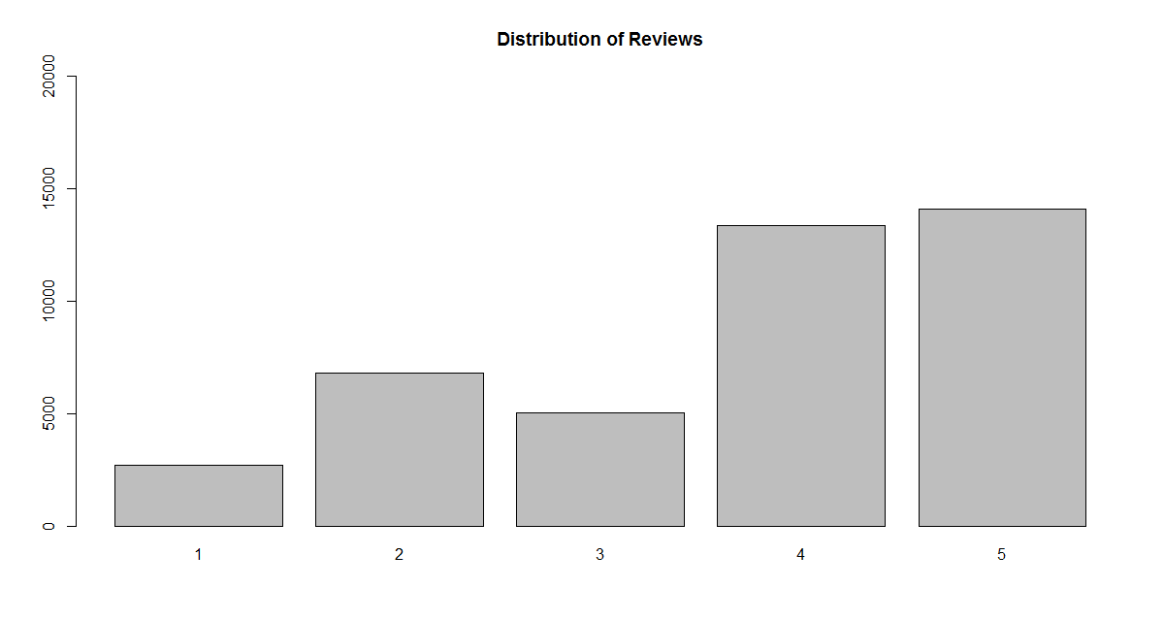
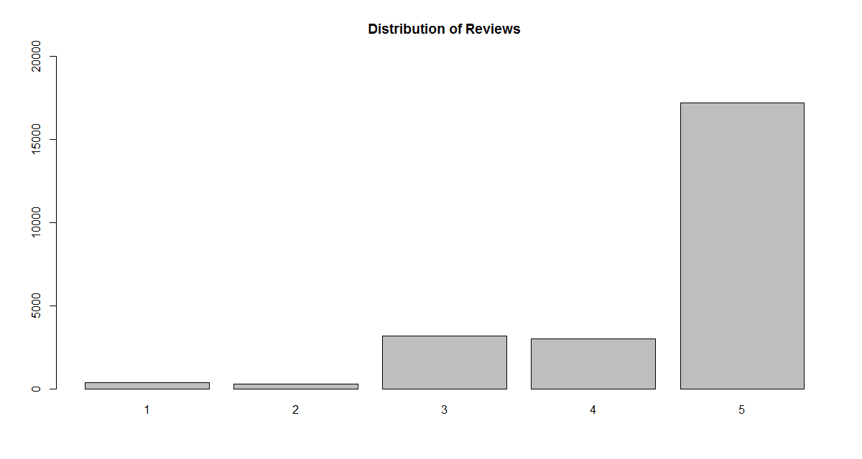
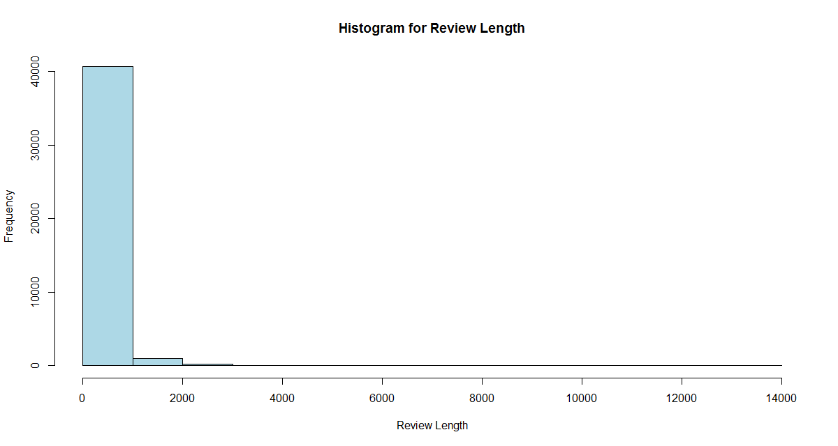
Current Status – Data Exploration
Comparison of Distribution of Reviews based on the ratings for “Gone Girl” on the left and “Hunger Games” on the right. “Gone Girl” has more suitable data for training the model as the distribution is more uniform than in case of “Hunger Games”
Most of the reviews in “Gone Girl” are less than 1000 characters. Omitting the ones >1000 characters helps maintain the complexity of test processing (bag of words) and is not likely to impact the model training

Slide 8
Current Status – Data Processing
Data Pre-processing
Apply NLP techniques to pre-process the data – tokenization, whitespace removal, lowercasing, removal of punctuation, removal of numbers
Remove the stop-words – common words that do not define the sentiment (e.g., “a”, “if”, “am”, etc.)
Vectorization of words (Corpus) and Generation of Document-Term matrix
Two types of R packages used and compared – TM package and Quanteda package
Sentiment Extraction –
Two types of sentiment extraction approach – Machine Learning based and Non-Machine Learning based
Non-Machine Learning based approach – compare the bag of words with a standard pre-defined list of positive and negative words
Machine Learning based approach - Create a Machine Learning model (using a classification technique such as Naive Bayes) which uses the existing ratings and the corresponding tokenized bag of words to classify the sentiment into desire categories

Slide 9
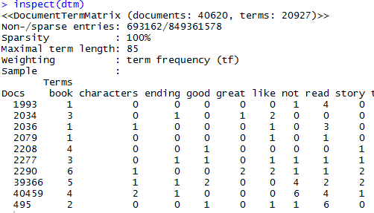
Current Status – Data Processing
Sample output of Document Term Matrix
Docs – Each review in the dataset (book)
Terms – Tokenized words
Numbers in each cell (row, column) indicate the frequency of that term occurring in the review. This plays a crucial role in training the Classification algorithm.
The curious case of the NOT’s
When a word is preceded by a NOT (or similar words such as isn’t, aren’t) then the sentiment changes (for example, “good” and “not good”, “disappoints” and “doesn’t disappoint”. This needs to be carefully handled before the modeling.

Slide 10
Current Status – Model Creation
Model Creation
Naive Bayes model to classify the sentiments – “Positive”, “Neutral”, “Negative”
Approach –
Create a prototype model for the book selected as the best fit for training in the data-exploration phase
Validate and test the model using on the same dataset
Test the model on other books
Measure the accuracy of the results
Re-train the model based on observations until the accuracy improves
Currently model creation and validation is in progress

Slide 11
Challenges & Risks
Challenges Faced
Time taken to explore the unknown area of text processing – exploring available packages, their functionalities, ease of use, suitability, etc.
Deciding on the programming language (R vs Python) by weighing the PRO’s and CONs of each
Segmentation of the modules difficult due to relatively low subject-matter expertise and hence ability to distribute work, overall productivity and overall efficiency are rendered low
Risks
The extent of possible multiple iterations and rework required on the model to achieve meaningful accuracy is unknown at this point

Slide 12
Next Steps
Complete the prototype classification model and measure accuracy (ETA : 19-Aug)
Handle the case of NOTs (ETA : 22-Aug)
Expand the model to incorporate all books (ETA : 29-Aug)
Iterations and Rework on the model (ETA : 16-Sep)
Handle outliers and data excluded from the first cut (ETA : 16-Sep)
Create Final Project Report (ETA : 23-Sep)
Targeted expansions within the project scope (to be taken up depending on the time availability) –
Replicate the project in Python (we are currently using R)
Multiple output levels for the sentiment (currently we have three – positive, neutral and negative)

Slide 13

Questions

